Slide 1

Members: Von Jaycel Bas Lyndon Charls Lawagon Steven Bunado Regie Garcia
Kent Jason Teofilo Jhen Rhea Sabal Bea Parmis Alaiza Leoligao
Catherine Cuizon Esconde
HOME
DISCUSSION
CONCLUSION
Presented by Group 3

Slide 2
HOME
DISCUSSION
CONCLUSION
INTRODUCTION TO
G3 GADGET WEBSTORE
Presented by Group 3

Slide 3

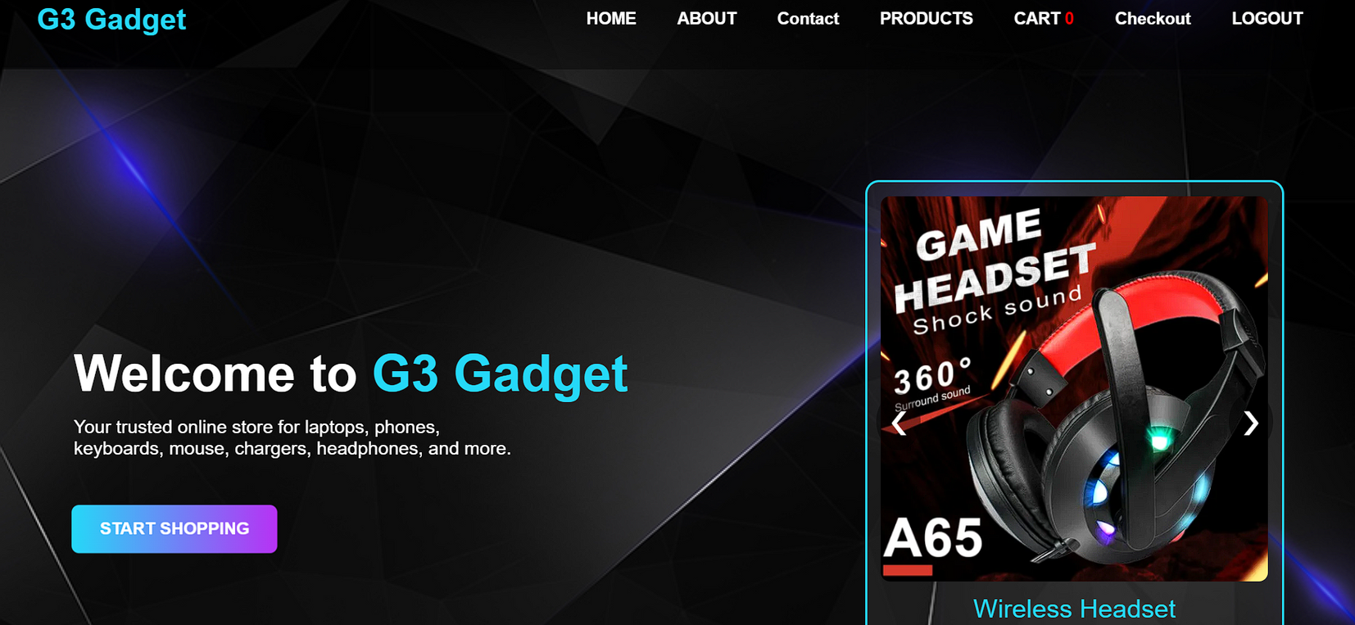
HOME
DISCUSSION
CONCLUSION
Welcome to Our G3 Gadget
The G3 Gadget Webstore is an interactive and beginner-friendly online platform designed to demonstrate my skills in HTML, CSS, and JavaScript, allowing users to browse a variety of gadgets, view detailed product information, add items to the cAart, and proceed through a simulated checkout process, all within a modern, organized, and user-friendly interface that reflects a realistic online shopping experience while highlighting both functionality and design creativity

Slide 4
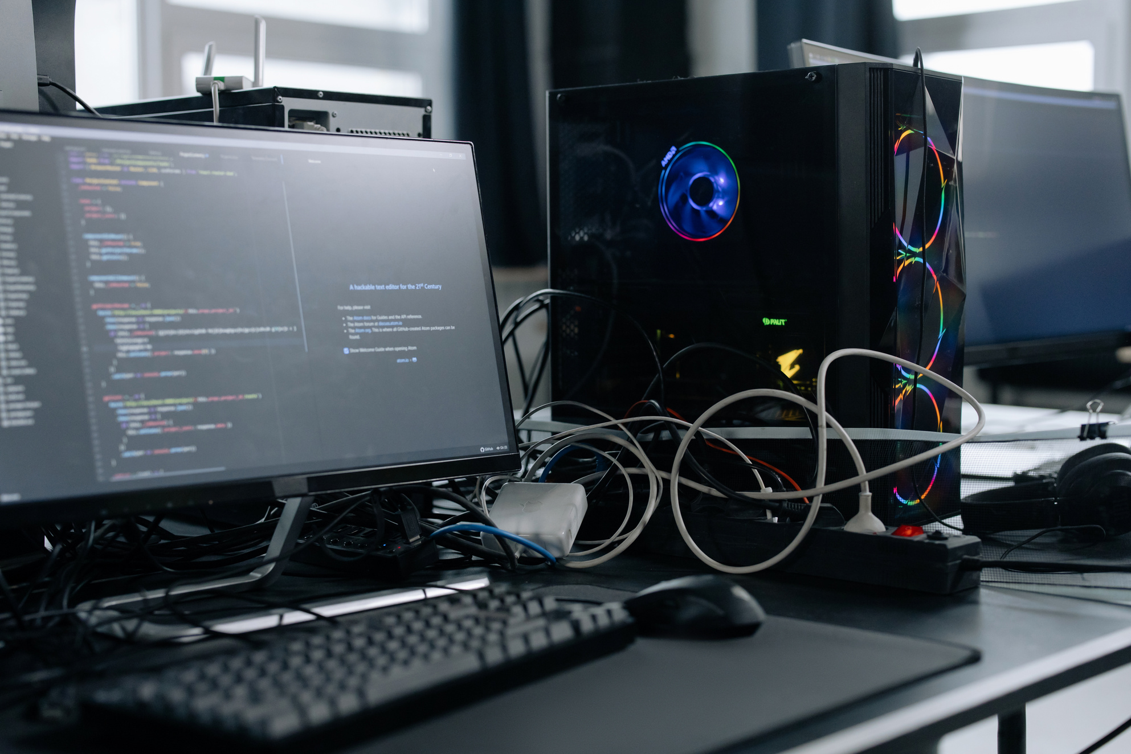
HOME
DISCUSSION
CONCLUSION
Project Overview
GadgetShop is an webstore for tech products.
Features a clean, simple layout for beginners.
Includes interactive elements like product slider and animations.

Slide 5
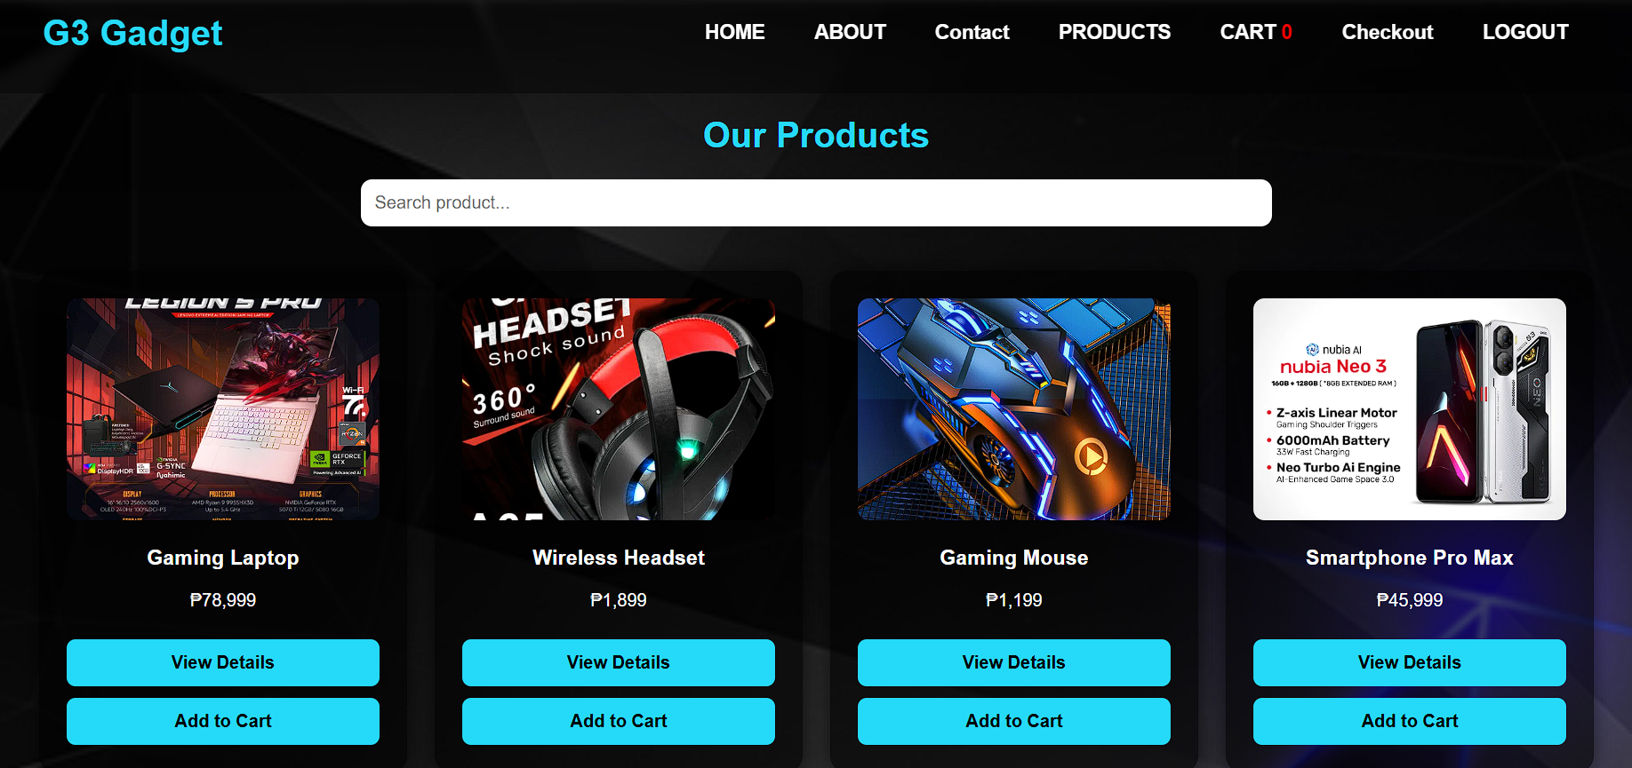
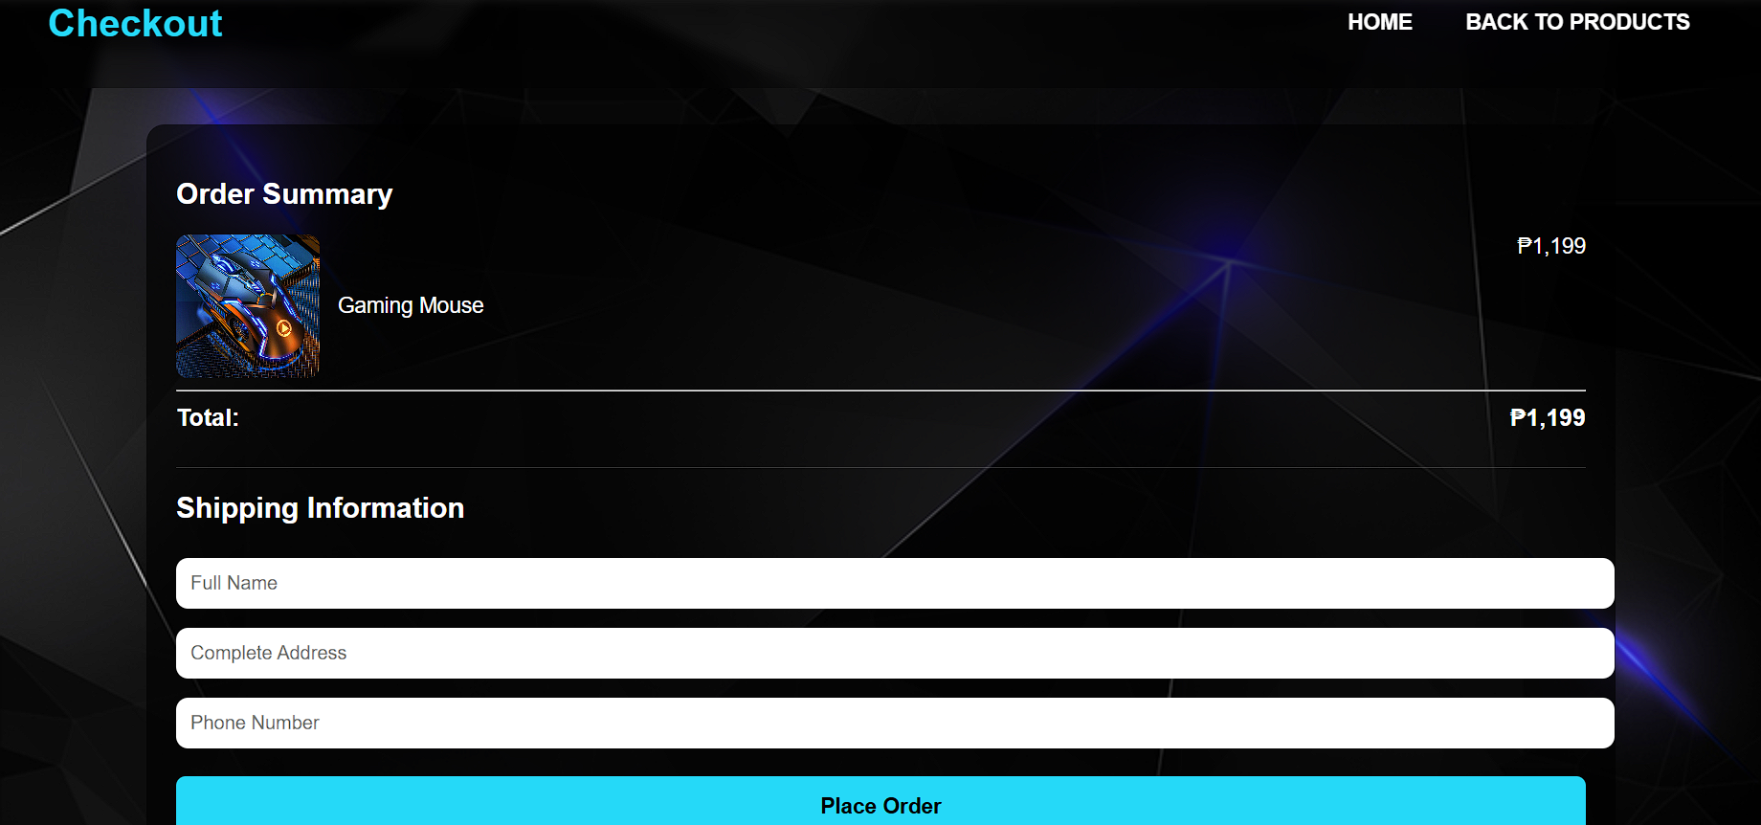
HOME
DISCUSSION
CONCLUSION
Main Features
Product listings with image, name, and price
Add to Cart functionality with item counter
Search bar for product filtering
Product Details page
Buy Now / Checkout page

Slide 6
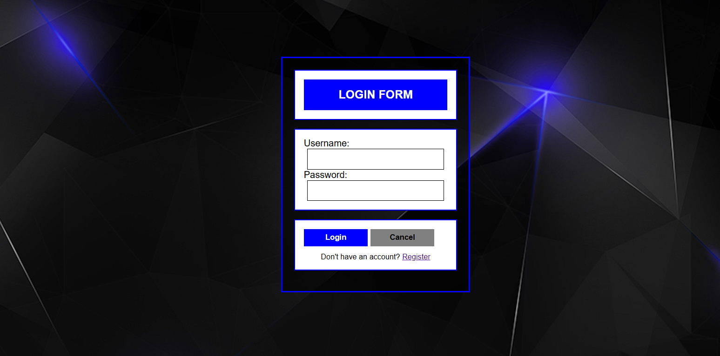
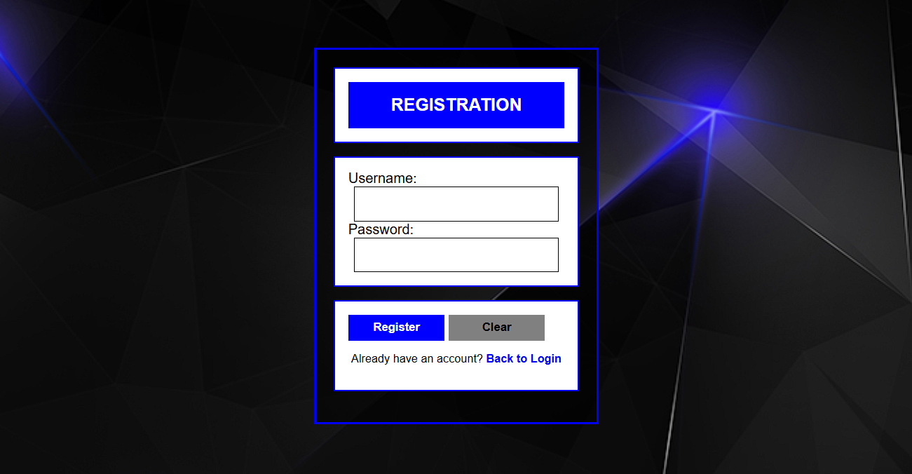
HOME
DISCUSSION
CONCLUSION
Log in page and Verification page
Login Page
Registration Page

Slide 7
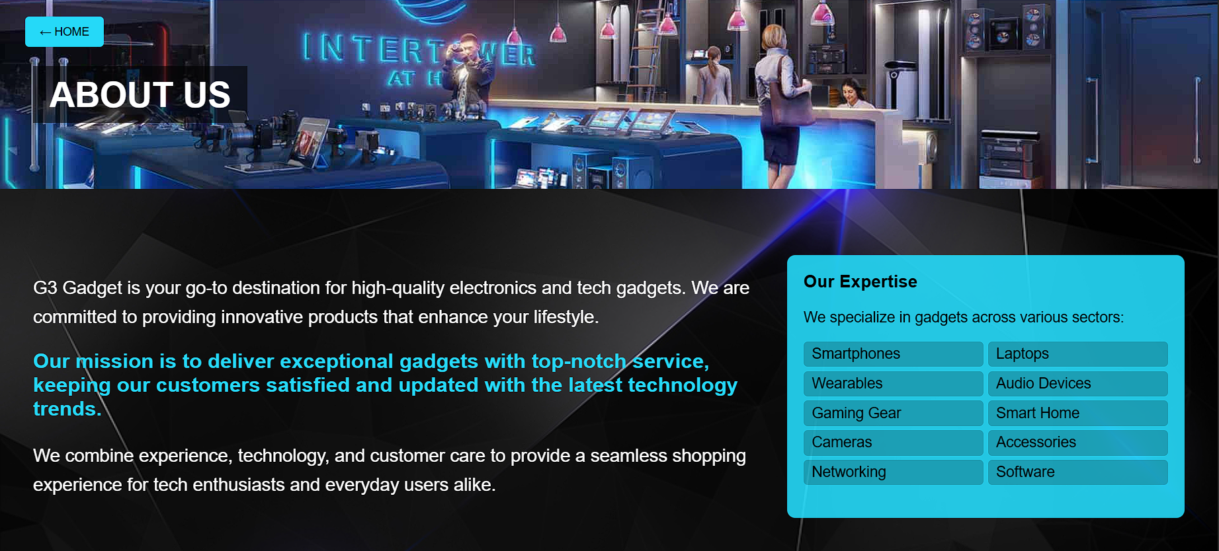
HOME
DISCUSSION
CONCLUSION
About Us Page
The About Us Page is where users can learn more about the purpose, vision, and background of the G3 Gadget Webstore. It helps give your project a professional and complete feel by showing the people and ideas behind the store. Highlights the goal of the webstore, such as providing a simple, interactive platform to browse and simulate buying gadgets. Shows the educational purpose of the project, demonstrating web development skills.

Slide 8
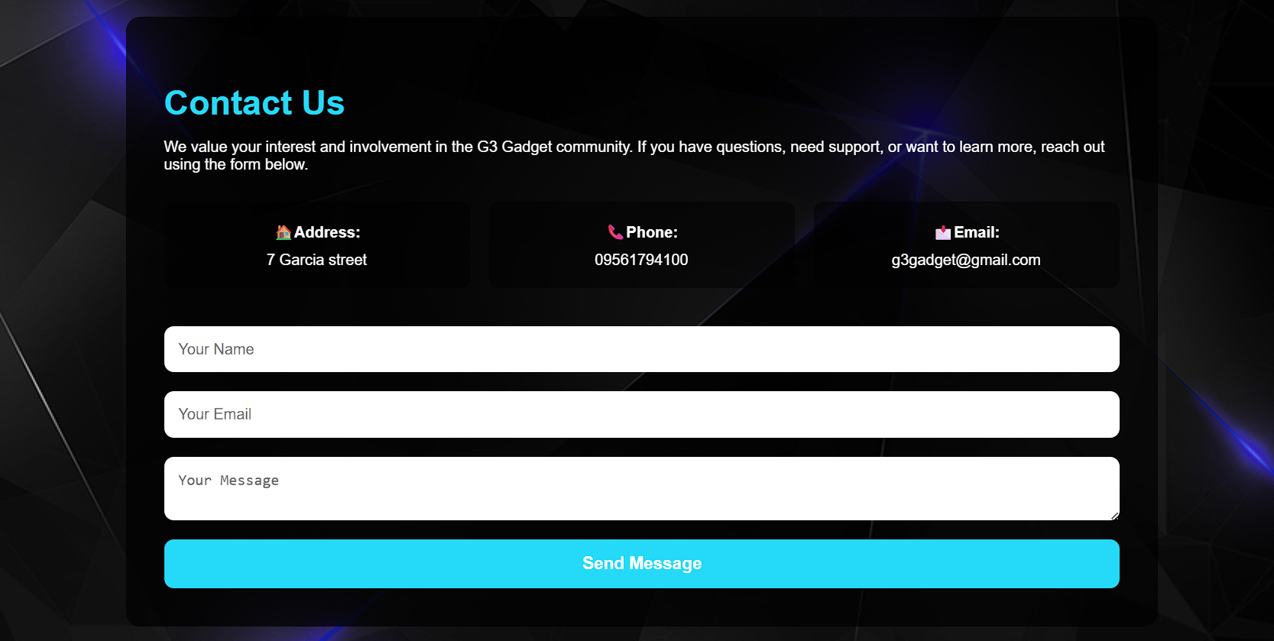
HOME
DISCUSSION
CONCLUSION
Contact us Page
The Contact Us Page allows users to reach out to the store owners or project creators for questions, feedback, or support. It is an important part of a professional webstore, showing how users can communicate with the team. Users can fill out fields such as name, email, subject, and message. Makes it easy to simulate sending a message to the webstore team. When users click submit, it can show a confirmation message. Demonstrates interactive functionality using JavaScript.

Slide 9
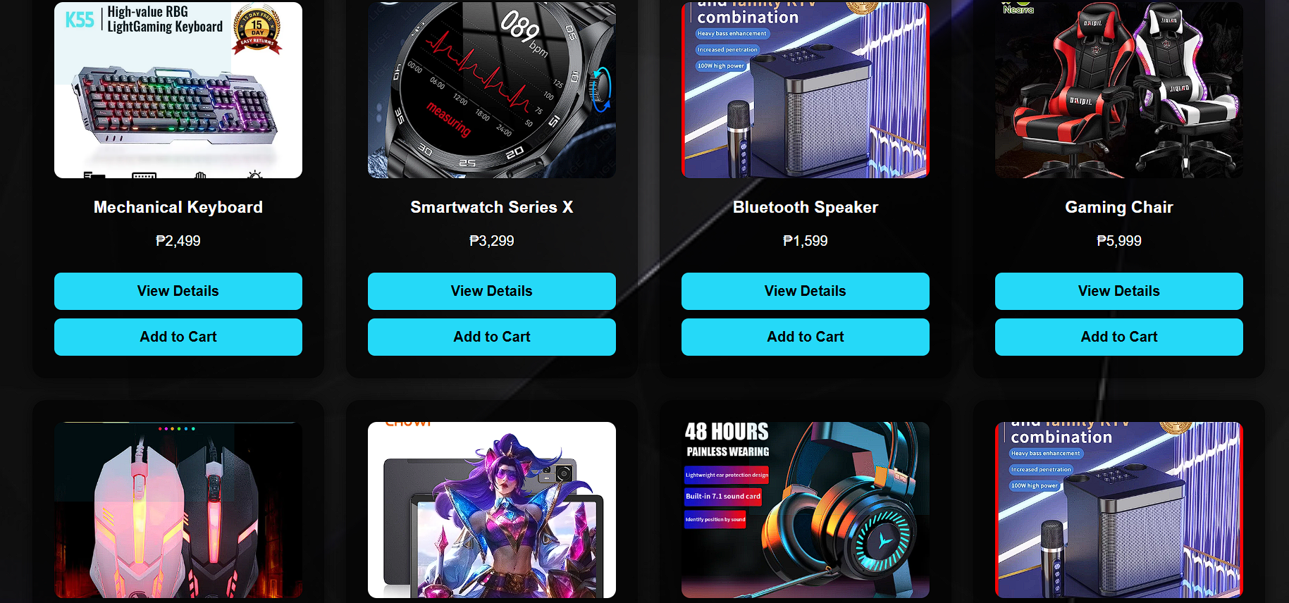

HOME
DISCUSSION
CONCLUSION
Product Page
The Product Page is where users can see all the gadgets available in our store. It is designed to be simple, organized, and easy to navigate. Each product is shown with an image, name, price. The layout allow user to see multiple products at once . Users can use search for product using search bar, making it easy to find a specific gadgets. When a product is added to the cart, the cart count updates automatically.

Slide 10
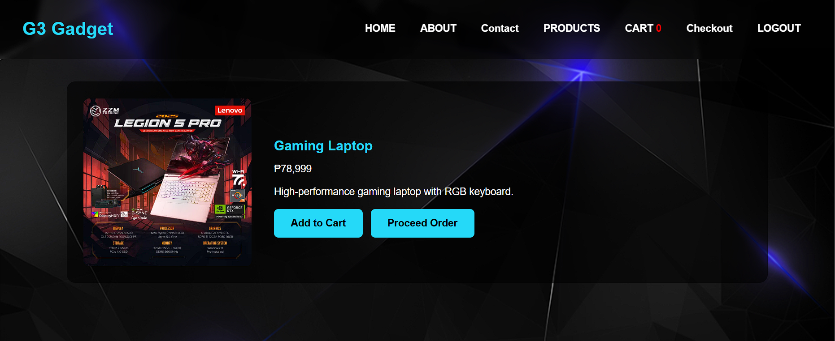
HOME
DISCUSSION
CONCLUSION
Product Details Page
The Product Details Page is designed to give users more information about a specific gadget before they decide to purchase it. It complements the Product Page by providing a detailed view of the selected item. Shows the name of the product and its price clearly, making it easy for users to know exactly what they are buying. Includes specification, features, or any important details about the gadget.

Slide 11
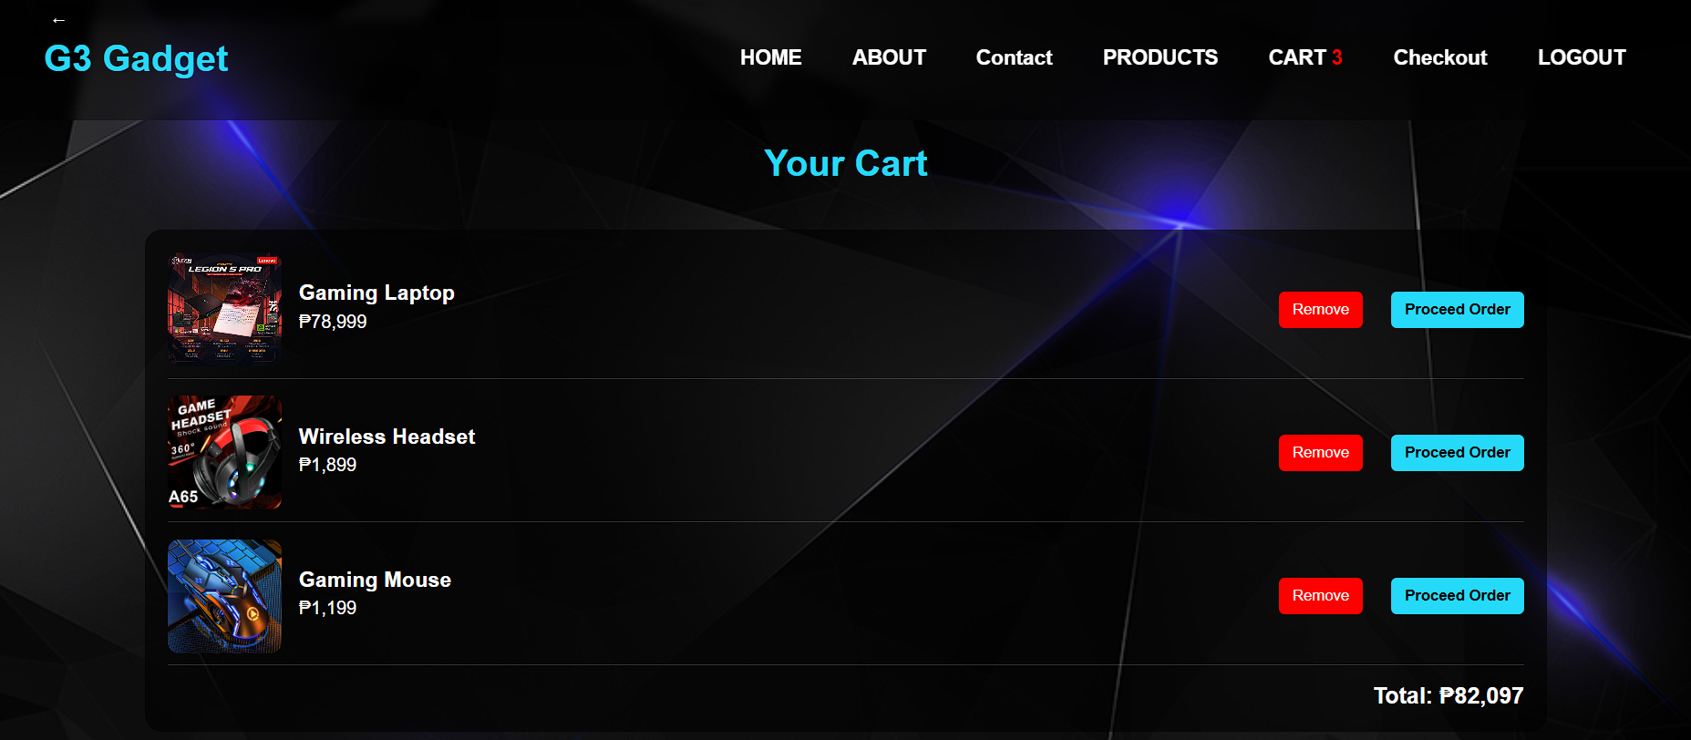
HOME
DISCUSSION
CONCLUSION
Cart Page
The Cart Page is where users can review the items they have added before proceeding to checkout. It is a key part of the webstore, showing how products are managed and prepared for purchase. Displays each selected product with its image, name and price. Allows users to see exactly what they are buying. Users can remove items (if implemented). Shows the total price for all items in the cart. Add to Cart updates When a product is added from the Product Page, it appears immediately in the cart. The total cost updates automatically based on the quantity and items. Shows the number of products added in the cart.

Slide 12
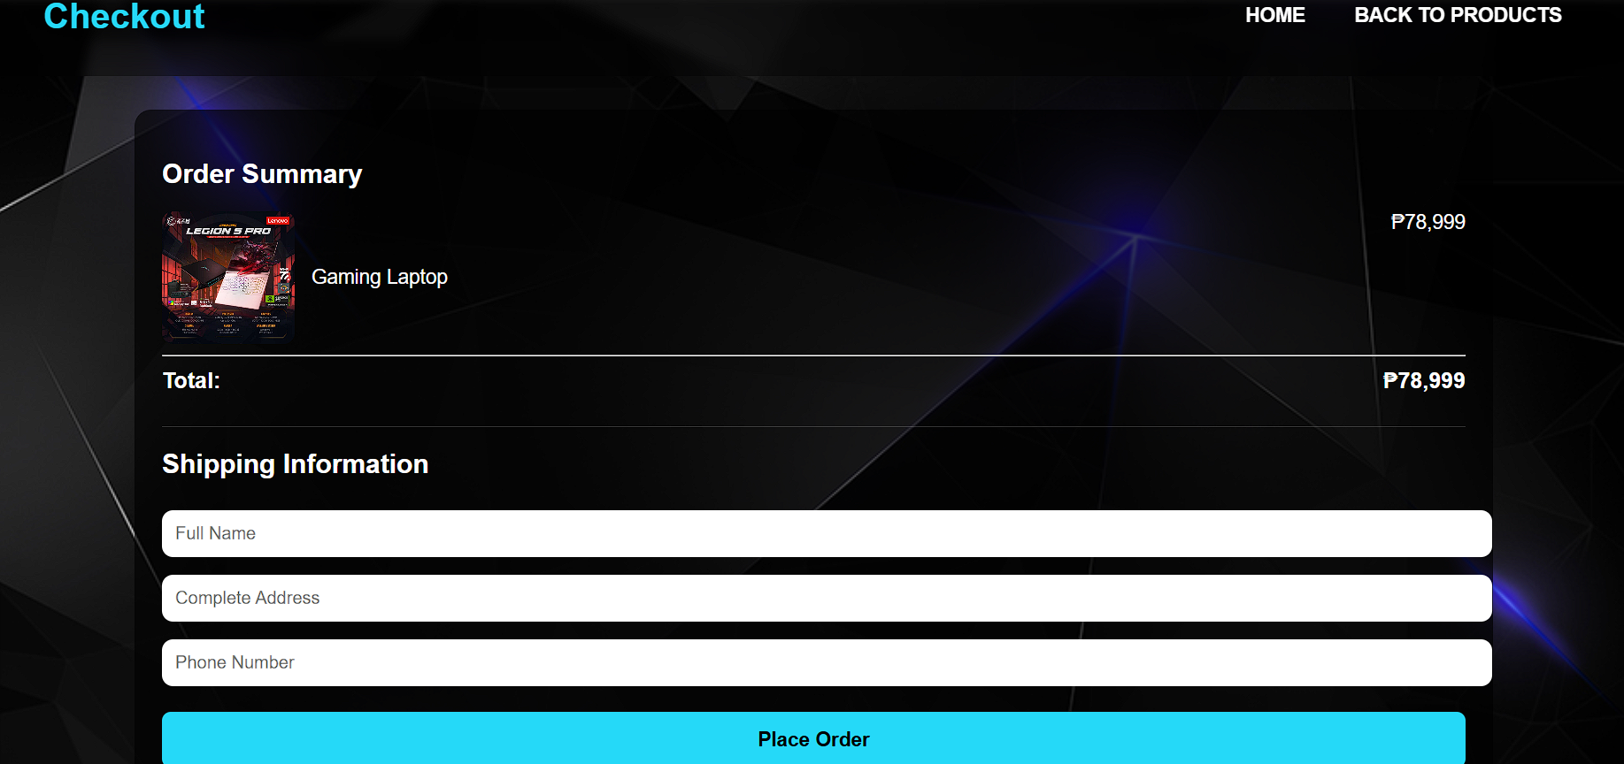
HOME
DISCUSSION
CONCLUSION
Check out Page
The Checkout Page is the final step in the shopping process where users finalize their purchase. It simulates a real-world online store checkout experience. Allows users to input details such as name, address, and contact information (for simulation purposes). Helps demonstrate how real e-commerce sites collect essential customer info.

Slide 13
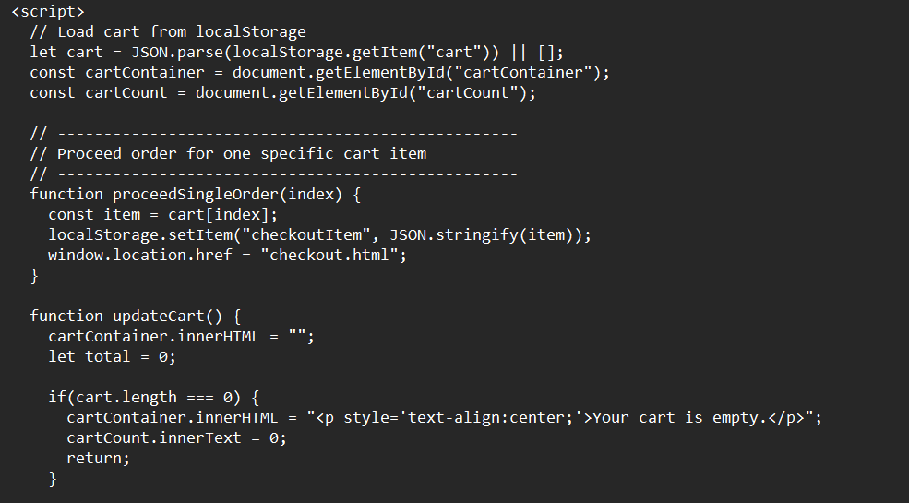
HOME
DISCUSSION
CONCLUSION
JavaScript Functions
• Add to Cart system
• Updating total price
• Counting cart items
•Showing selected product details

Slide 14
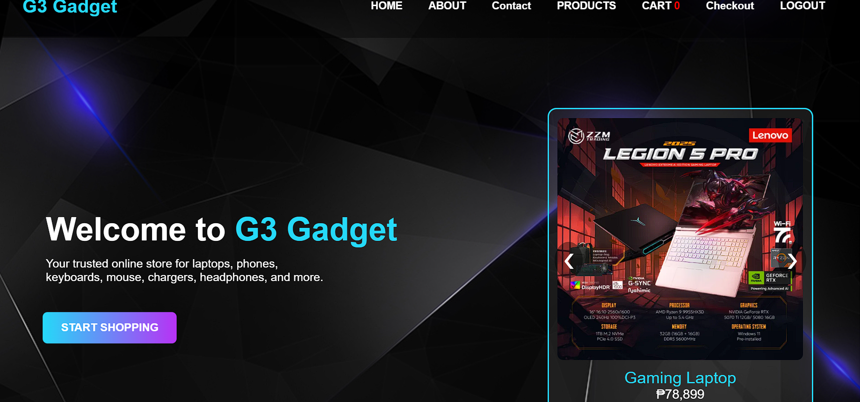
HOME
DISCUSSION
CONCLUSION
Instead of making a random or simple website, we chose an offline store (soon we will upgrade it to online store) because webstores are very common in real life.
People use them every day Shopee, Lazada, Amazon so creating our own version shows real-world skills.
Why we choose to create G3 webstore
1. We Wanted a Webstore Theme That Fits Our Interests
Among all possible store themes (clothes, food, accessories), our group chose gadgets because:
We are interested in technology
We enjoy exploring devices like phones, speakers, earphones, watches, etc.
It’s fun and exciting to design a store based on items we actually like
This made the project more engaging and meaningful for us.

Slide 15
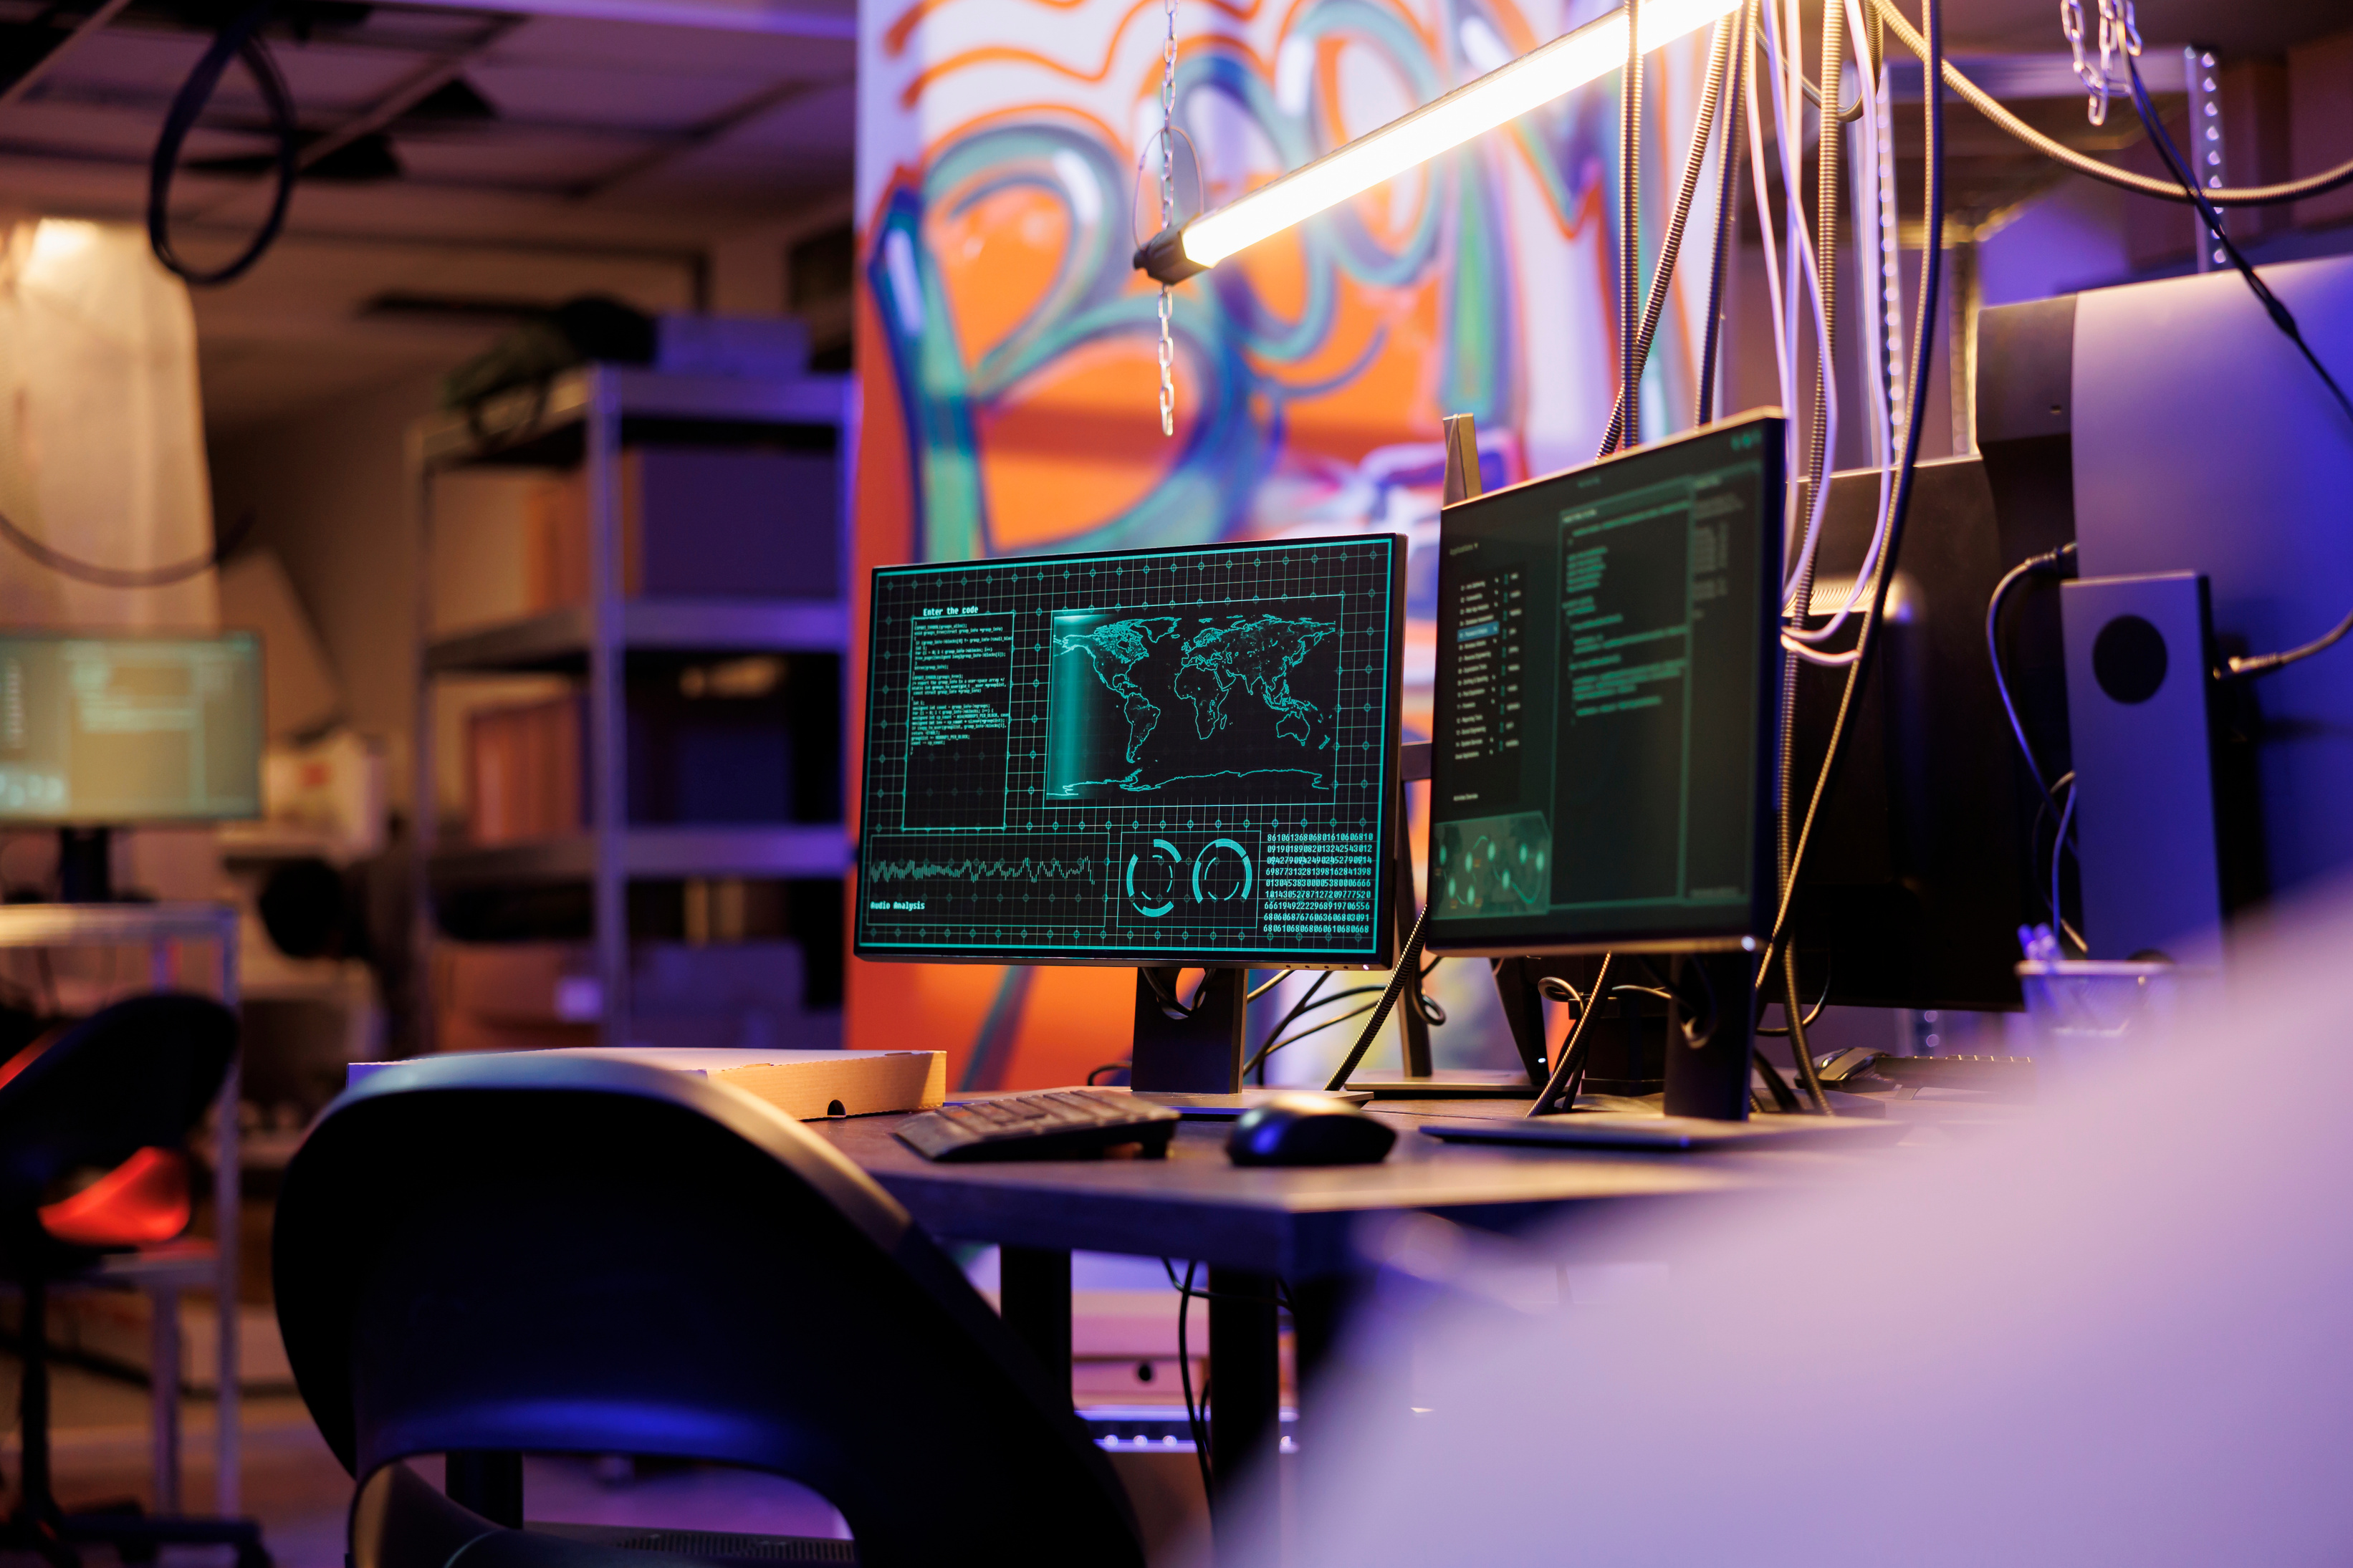
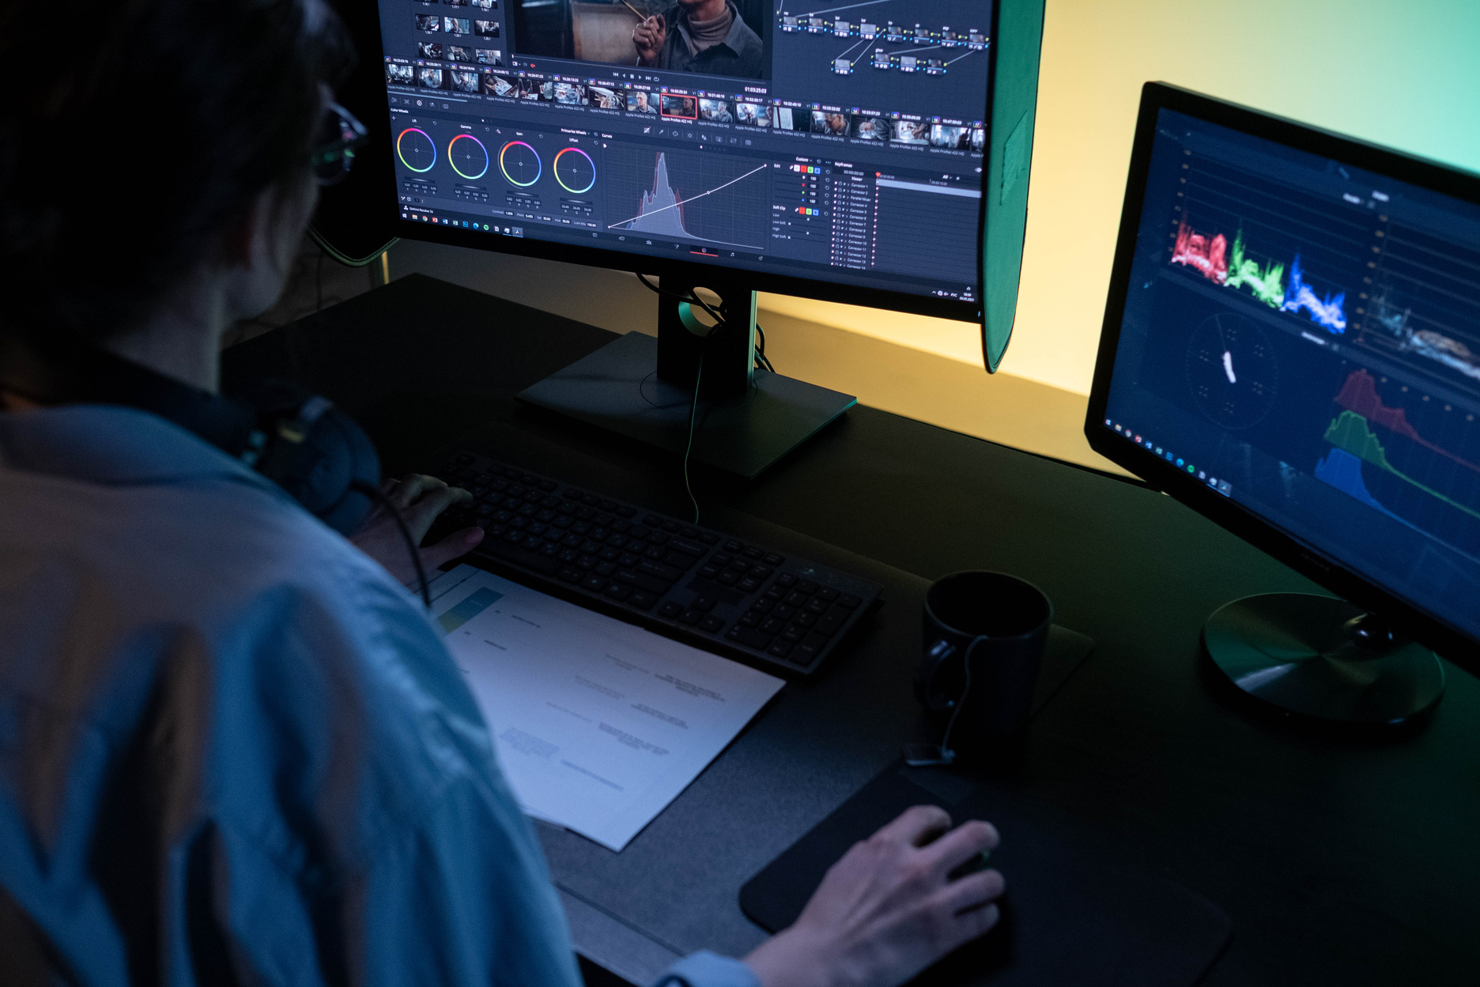
HOME
DISCUSSION
CONCLUSION
Summary
The G3 Gadget Webstore is a simple but functional store created using HTML, CSS, and JavaScript. It features a modern dark-themed design and showcases different tech products such as earphones, smartwatches, and speakers. The webstore includes multiple pages: a homepage, a products page, a product details page, a cart page, and a checkout page.
Users can view products with images, names, and prices, and they can also use the Add to Cart system, which updates the cart count and total price using JavaScript. The site also includes a search bar for filtering items and smooth animations to improve user experience.
Overall, the G3 Gadget Webstore demonstrates basic web development skills and shows how a beginner-friendly design can still look professional, organized, and functional.

Slide 16
HOME
DISCUSSION
CONCLUSION
Thank You
Presented by Group 3

